Slide 1
Credit Card Fraud Detection Using Machine Learning
: Analyzing transaction data to identify fraudulent activity
By rini kaur Chhabra
Date: [25-05-2025]

Slide 2
Introduction
Credit card fraud is a significant threat causing financial losses to consumers and banks.
Fraudulent transactions are increasingly sophisticated and hard to detect manually.
Machine learning models can help automatically detect and prevent fraud.

Slide 3
Problem Statement
Detecting fraud is challenging due to the large volume of transactions and the rarity of fraud cases.
Fraudulent transactions are only a tiny fraction of all transactions, creating an imbalanced dataset.
Effective detection requires high accuracy to minimize false positives and false negatives.

Slide 4
Dataset Overview
Dataset contains [insert number] credit card transactions.
Features include transaction amount, time, and anonymized variables (V1, V2, ..., V28).
Target variable: Class (0 = Legitimate, 1 = Fraud).
Fraud cases represent only about 0.17% of all transactions.

Slide 5



Data Visualization
To better understand the dataset and uncover hidden patterns, we used visual analysis techniques.
The following visualizations help explore class imbalance, feature behavior, and relationships between variables.
These insights guide preprocessing and improve model performance.

Slide 6
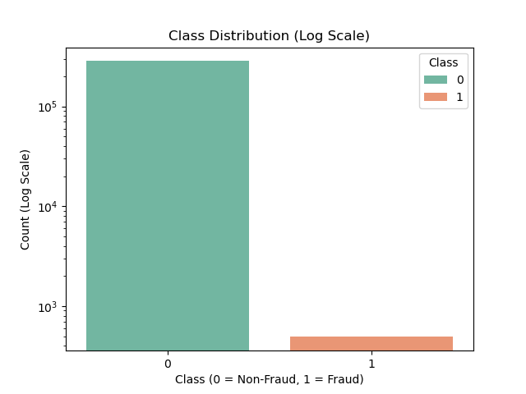
Class Distribution (Count plot) Title: Class Distribution of Transactions
Most transactions are non-fraud (class 0), while fraudulent ones (class 1) are very few.
This severe class imbalance (approx. 0.17% fraud) makes it a challenging classification problem.
The model must be sensitive enough to detect the rare frauds without too many false alarms.

Slide 7
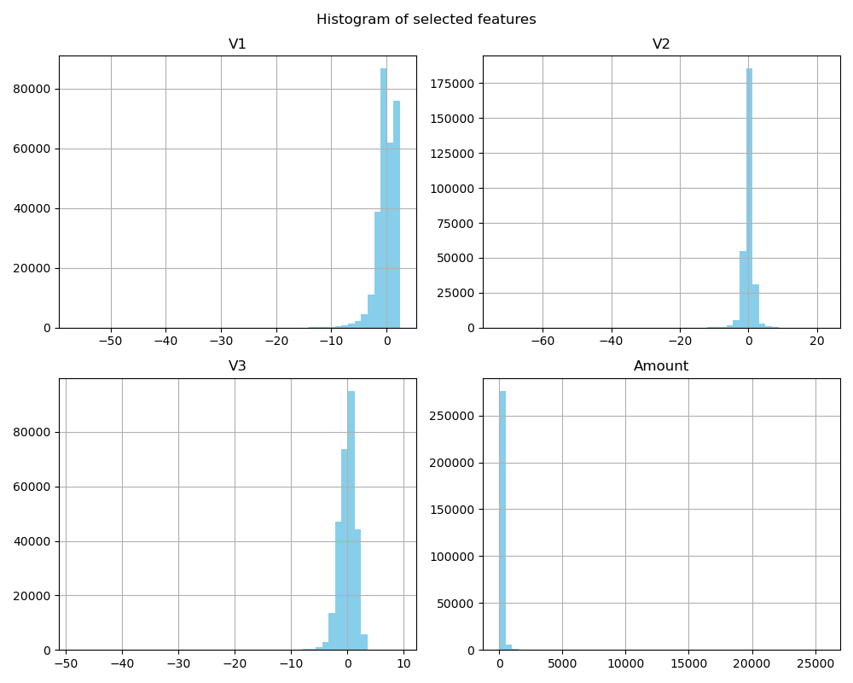
Histogram for Selected Features
The histograms below show the distribution of four important features: V1, V2, V3, and Amount.
These features display distinct patterns for fraudulent and legitimate transactions.
While V1–V3 are anonymized due to confidentiality, their distribution hints at possible separability between the two classes.
Amount is skewed and shows notable differences between fraud and non-fraud cases.
Visualizing feature distributions helps us understand data behavior and choose suitable preprocessing steps.

Slide 8
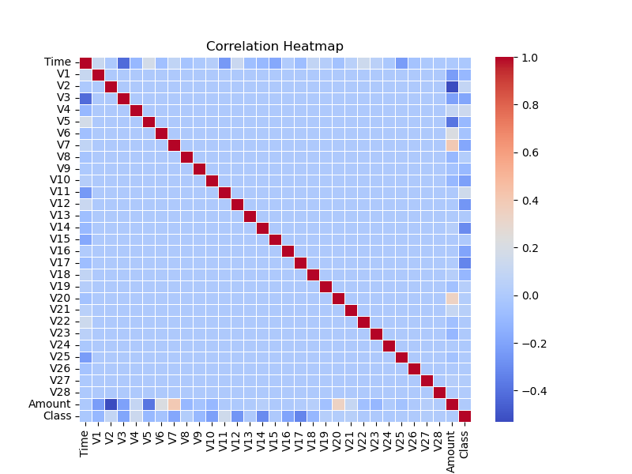
Correlation Heatmap Title: Feature Correlation Heatmap
Shows how strongly features are related to each other.
Strong correlations can affect model performance.
Helps in feature selection or dimensionality reduction if needed.

Slide 9
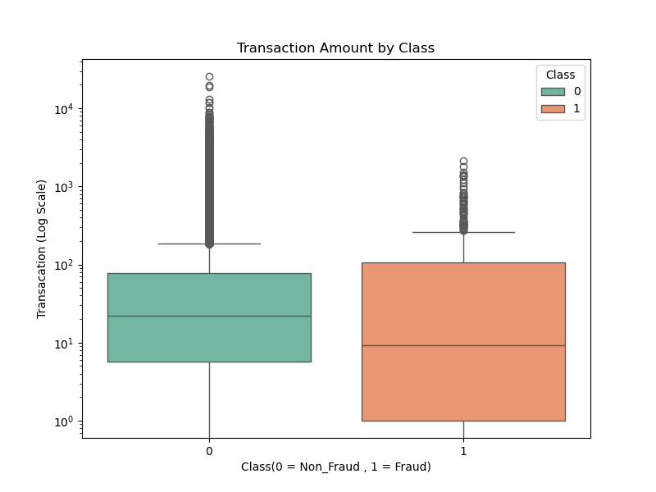
Boxplot of Amount by Class
Fraudulent transactions tend to have smaller or more variable amounts.
Useful in identifying outliers and suspicious patterns.
Boxplots help compare distributions visually.

Slide 10
Data Preprocessing
Data was checked for missing values (none found).
Features scaled using StandardScaler for better model performance.
Imbalanced dataset handled using techniques like undersampling or SMOTE (Synthetic Minority Over-sampling Technique).

Slide 11
Models Used
We implemented multiple classification algorithms:
Logistic Regression
K-Nearest Neighbors (KNN)
Decision Tree
Random Forest
Support Vector Machine (SVM)
Naive Bayes
XGBoost (Gradient Boosting)
Comparing models helps identify the best approach for fraud detection.

Slide 12
Model Evaluation Metrics
Accuracy: Overall correctness of the model’s predictions.
Precision: Fraction of predicted fraud cases that were actually fraud.
Recall: Fraction of actual fraud cases detected by the model.
F1-Score: Harmonic mean of precision and recall, balances false positives and false negatives.
ROC-AUC: Measures model’s ability to distinguish between classes (higher is better).

Slide 13
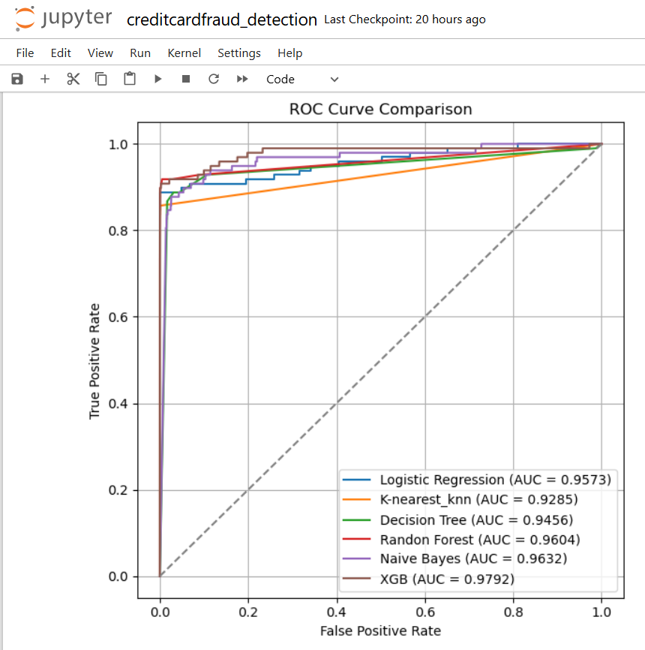
Results & Comparison
XGBoost achieved the highest ROC-AUC score of 0.9792, indicating excellent fraud detection ability.
SVM and Random Forest also performed well, with ROC-AUC scores above 0.96.
KNN had the lowest performance among the models tested.
Choosing the best model is crucial for real-world deployment.

Slide 14
ROC Curves
ROC curve plots True Positive Rate vs False Positive Rate at different threshold settings.
A model closer to the top-left corner indicates better performance.
XGBoost’s ROC curve shows superior trade-offs between sensitivity and specificity compared to other models.

Slide 15
Conclusion & Future Work
Machine learning models can effectively detect credit card fraud despite class imbalance.
XGBoost stands out as the most accurate model in this project.
Future improvements include real-time detection systems and incorporating additional features.
Thank you! Questions?

Slide 16
Thank You / Q&A
Thank you for your attention!
Any questions or feedback are welcome.
[Optional: Add your contact info]

